Slide 1
Pizza sales data analysis SQL project
This project involves analyzing a pizza sales dataset using SQL to uncover meaningful business insights.
Various SQL techniques—including ctes, subqueries, joins, window functions, and aggregate functions—were used to answer key questions about sales performance, customer behavior, and ordering patterns.
The goal of this analysis is to help stakeholders understand trends in revenue, popular pizza types, peak order times, and overall sales distribution, which can aid in making data-driven decisions to improve business performance.

Slide 2
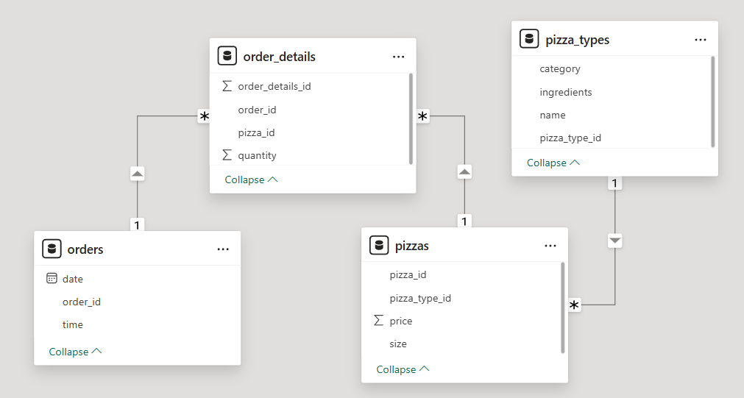
Data model
Visualizing relationships between the connected tables

Slide 3
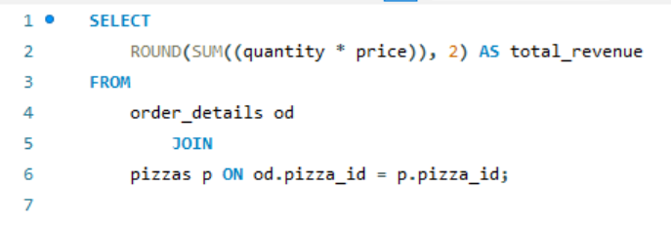
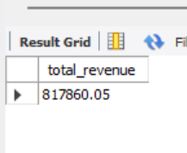
Calculate the total revenue generated from pizza sales.
SQL query

Slide 4
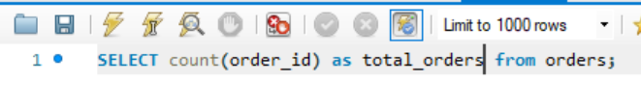
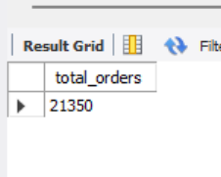
Retrieve the total number of orders placed.
SQL query

Slide 5
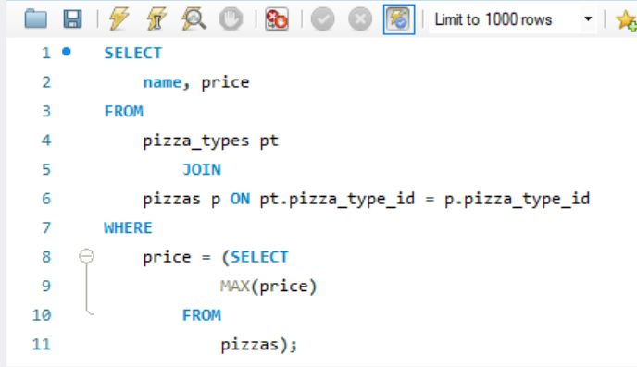
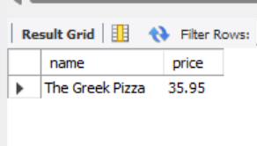
Identify the highest-priced pizza
SQL query

Slide 6
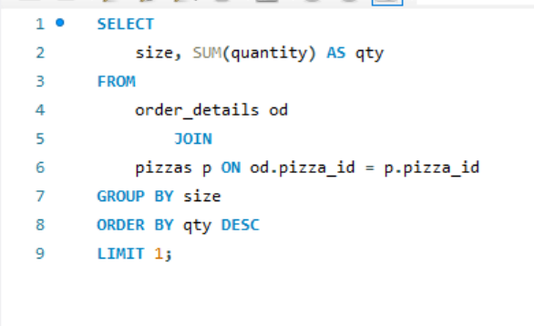
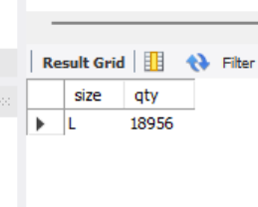
Identify the most common pizza size ordered.
SQL query

Slide 7
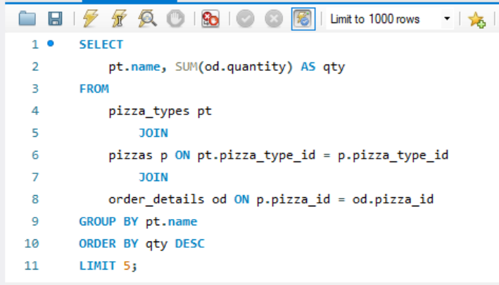
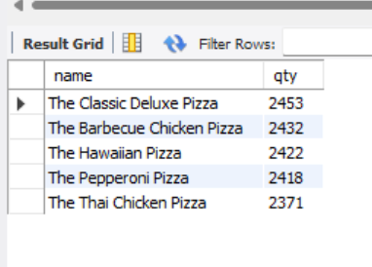
List the top 5 most ordered pizza types along with their quantities
SQL query

Slide 8
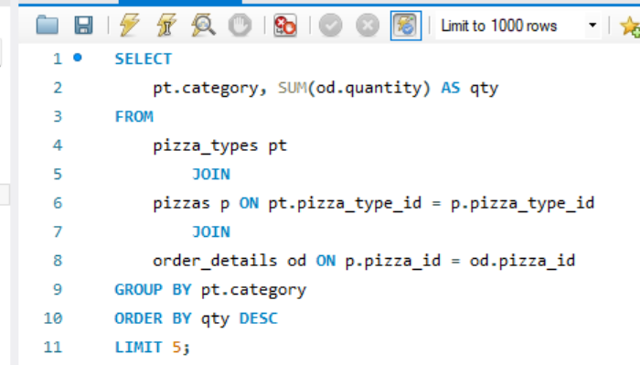
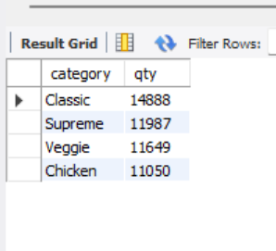
Join the necessary tables to find the total quantity of each pizza category ordered.
SQL query

Slide 9
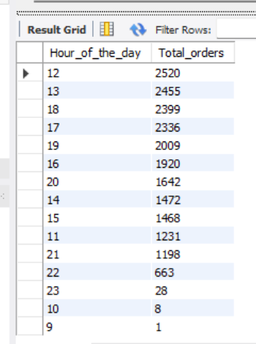
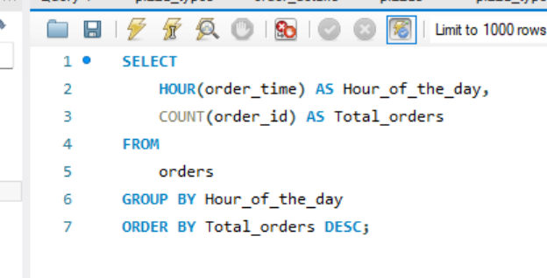
Determine the distribution of orders by hour of the day.
SQL query

Slide 10
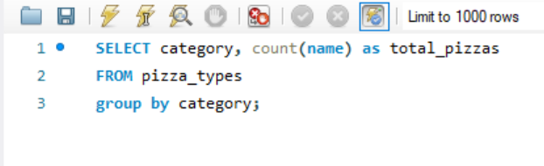
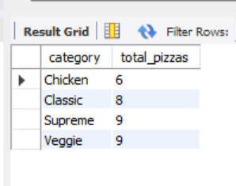
Join relevant tables to find the category-wise distribution of pizzas.
SQL query

Slide 11
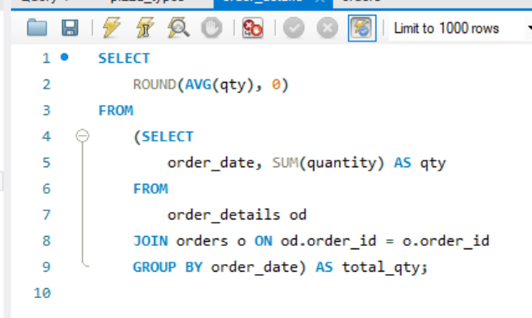
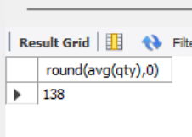
Group the orders by date and calculate the average number of pizzas ordered per day.
SQL query

Slide 12
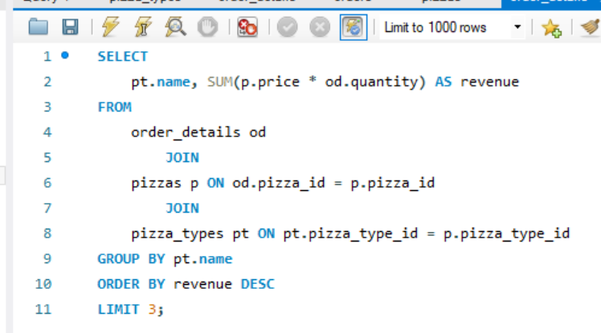
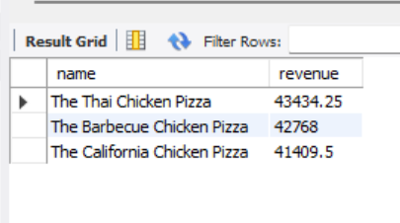
Determine the top 3 most ordered pizza types based on revenue.
SQL query

Slide 13
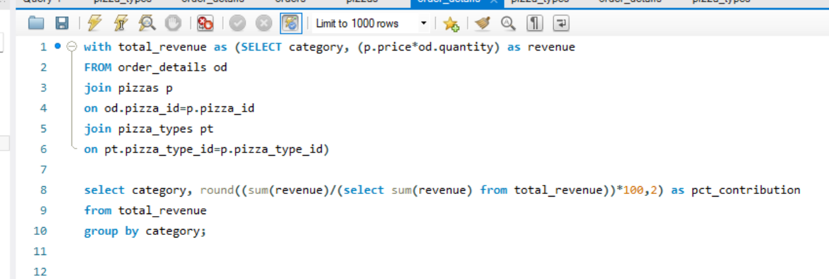
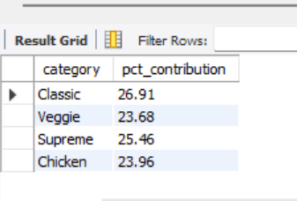
Calculate the percentage contribution of each pizza type to total revenue.
SQL query

Slide 14
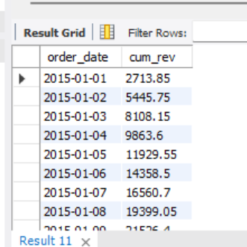
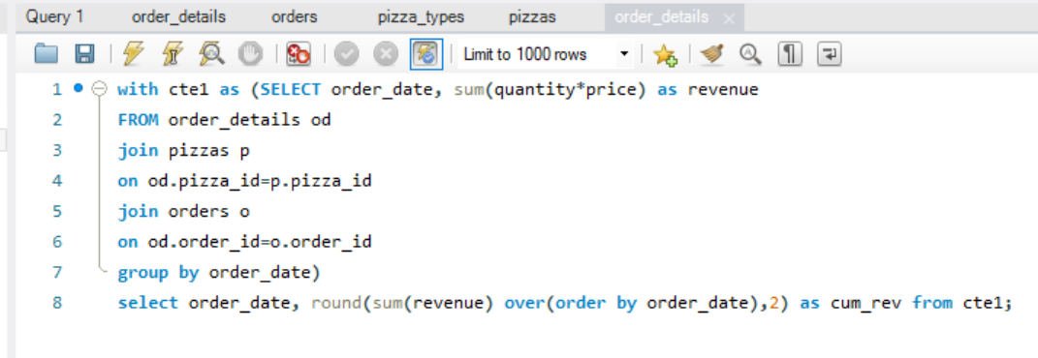
Analyze the cumulative revenue generated over time.
SQL query

Slide 15
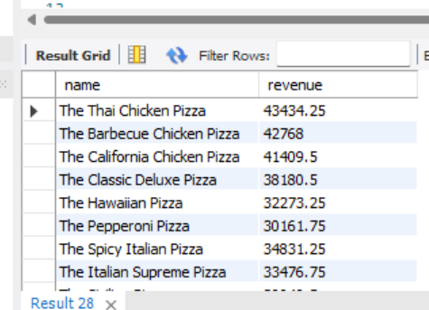
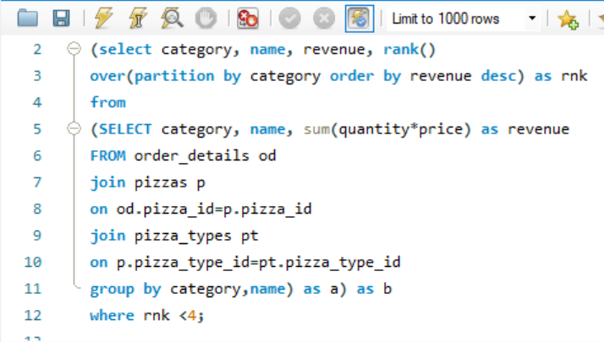
Determine the top 3 most ordered pizza types based on revenue for each pizza category.
SQL query

Slide 16
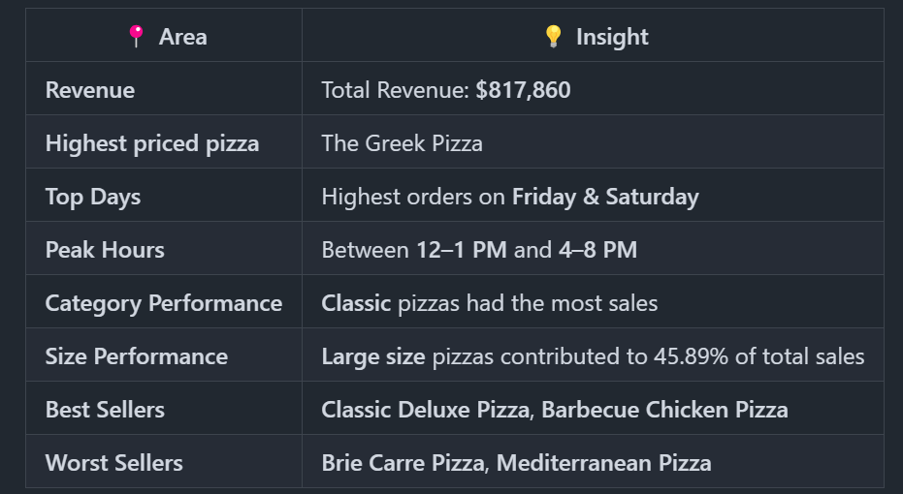
Insights from the analysis
Derived actionable insights such as top-performing pizzas, sales trends, customer ordering patterns, and more.

